Slide 1
Food Ordering System

Slide 2

Loknete Hanmantrao Patil charitable Trust, Vita Adarsh Institute of Technology & Research centre, Vita dept. of Computer Science and Engineering Roll No : CS2017 Class : CSE SY(B.TECH) Domain Name : HTML and CSS Seminar Title : Food Order Student Name : Mr. Suraj Appa Bansode Guide Name : 1] Mr. S.R.Mali 2]A.H.Pudale

Slide 3
Table of content:
1. Introduction
2. Existing System
3. Proposed System
4. Block Diagram
5. Advantages
6. Disadvantages
7. Application Areas
8. Conclusion
9. Reference
10. Thank you

Slide 4
Introduction:
This project aims at building a website that is designed for the food orders. It is an online website which is widely used to maintain several activities of the hotel and restaurant.
1.To store data.
2.Control orders and services.
3.Billing.
4.Control staff and their shifts.
5.Requirements of staff.

Slide 5
Existing System: 1. Customer should visit the location or place 2. Time as well as physical work require. 3. Traditional way of payment- cash mode 4.Offline cash is only 5.Not efficient.

Slide 6
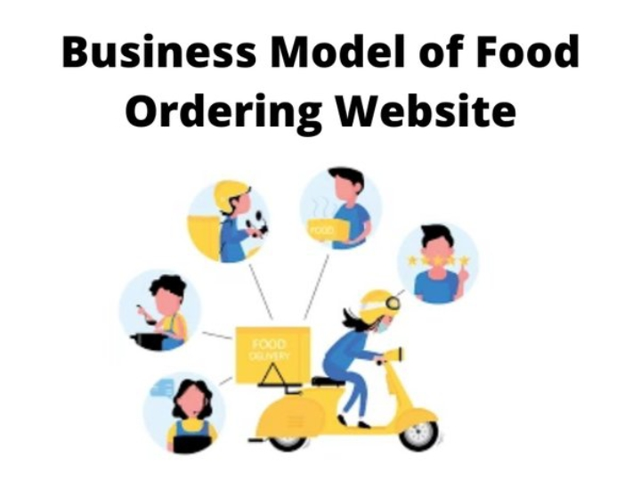
Proposed System: 1. More efficient. 2. Multiple choice. 3. Secure data. 4.Paper work reduces.

Slide 7
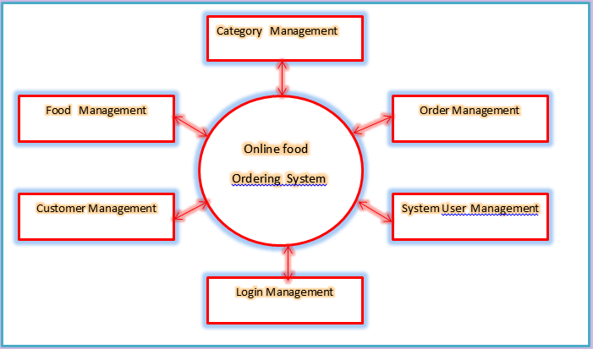
Block Diagram:

Slide 8
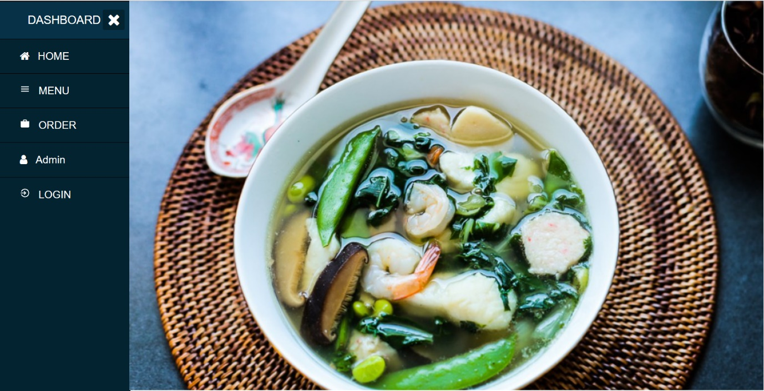
Dashboard

Slide 9
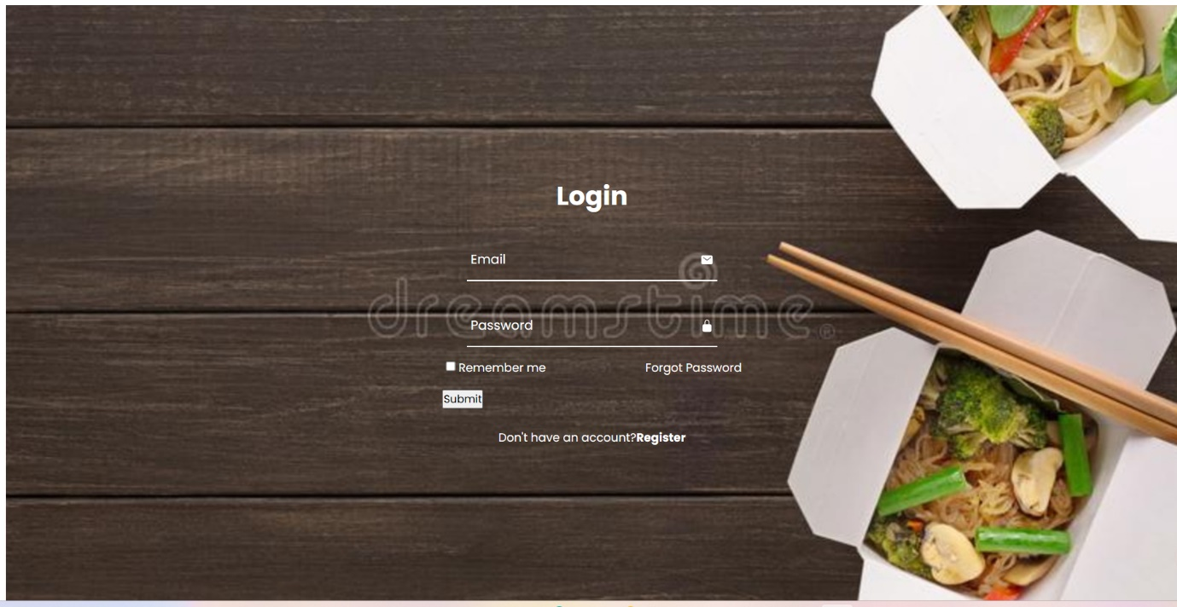
Login

Slide 10
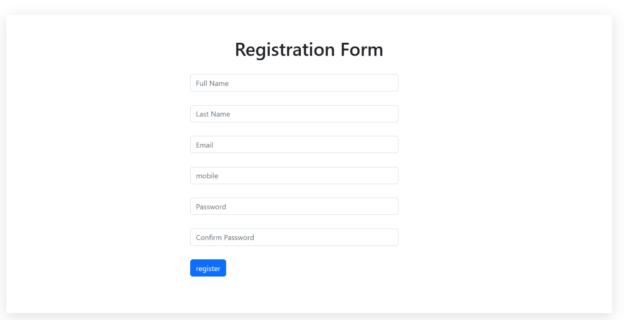
REgistration

Slide 11
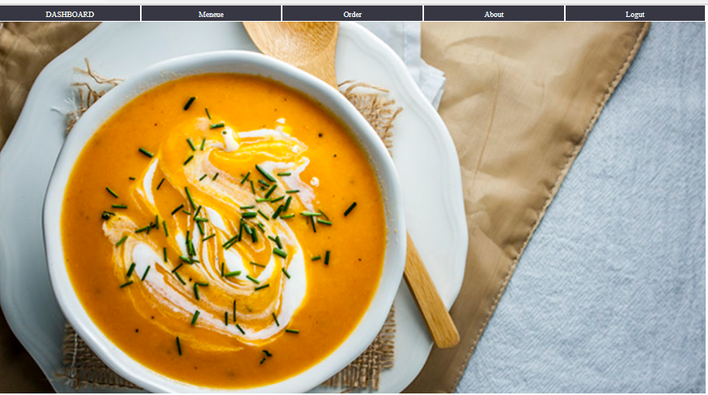
Home

Slide 12
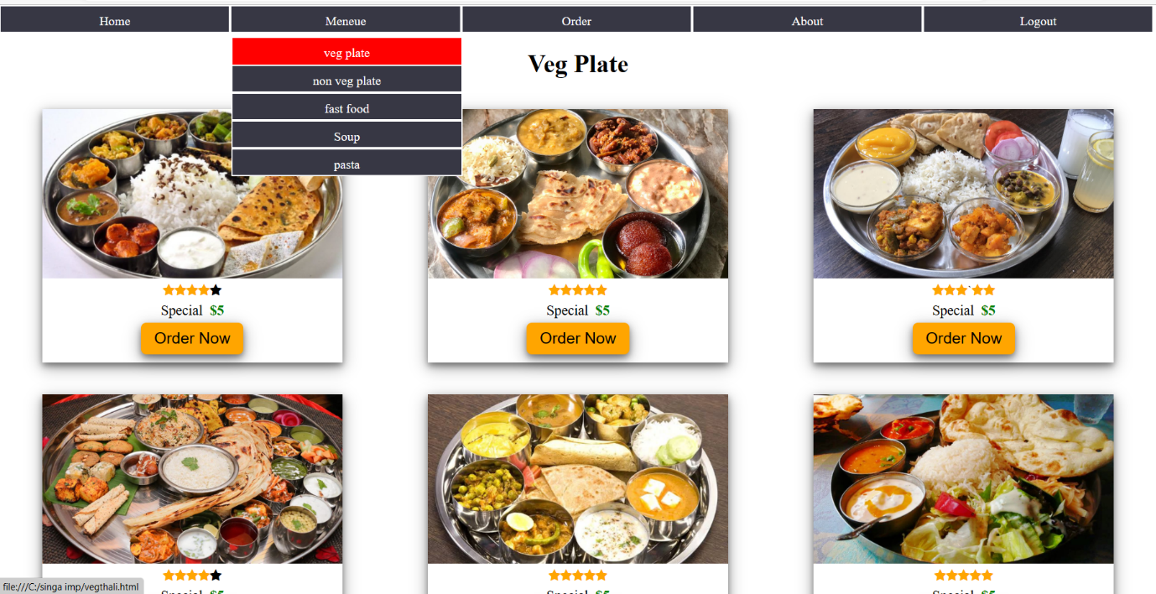
Menu

Slide 13
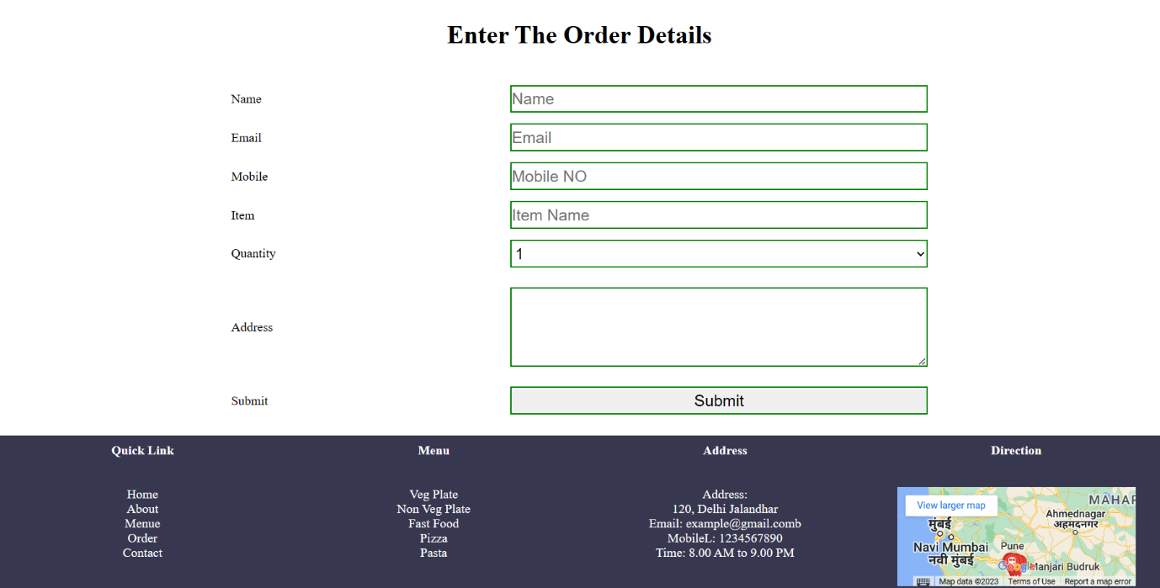
Order

Slide 14
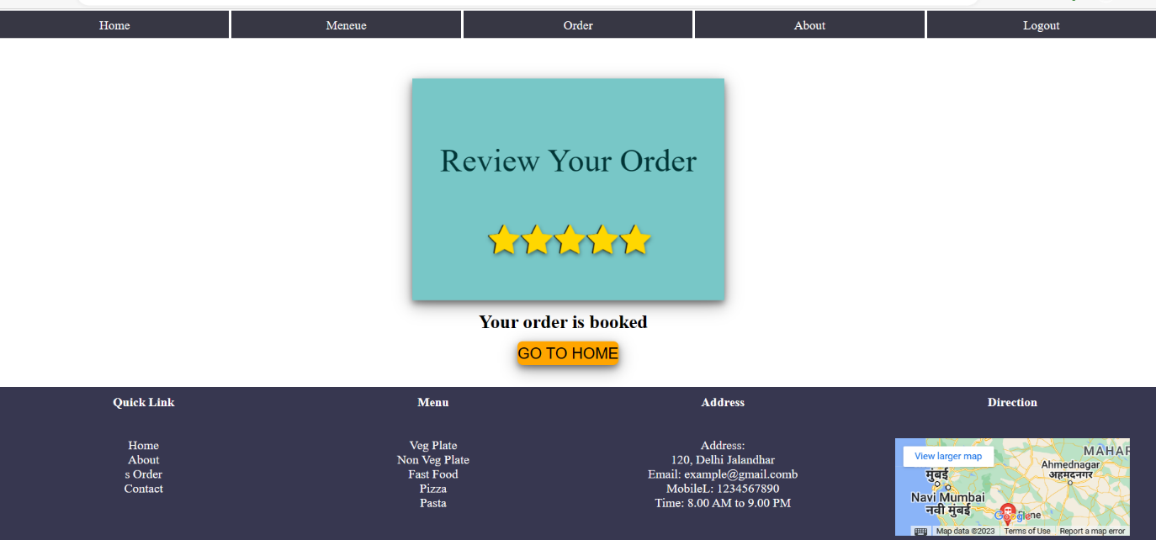
Review

Slide 15
Advantages :
1.Makes the ordering process easier.
2.Efficient customer and order management.
3.Free and cheap marketing.
4.Better customer data.
5.Its fast, easy and comfortable
6.No commission to pay.
7.Reduces error.
8.Live order tracking.

Slide 16
Disadvantages :
1.Food may get cold.
2.Chance of technical problem in system.
3.delay food deliver.

Slide 17
Conclusion : 1.Helps to making order easily 2.Helps to deliver order. 3.Help to book order. 4.No limitations in payment options.

Slide 18
Reference :
1. Google
2.Wikipedia.
3.Youtube

Slide 19
Thank You

